Slide 1
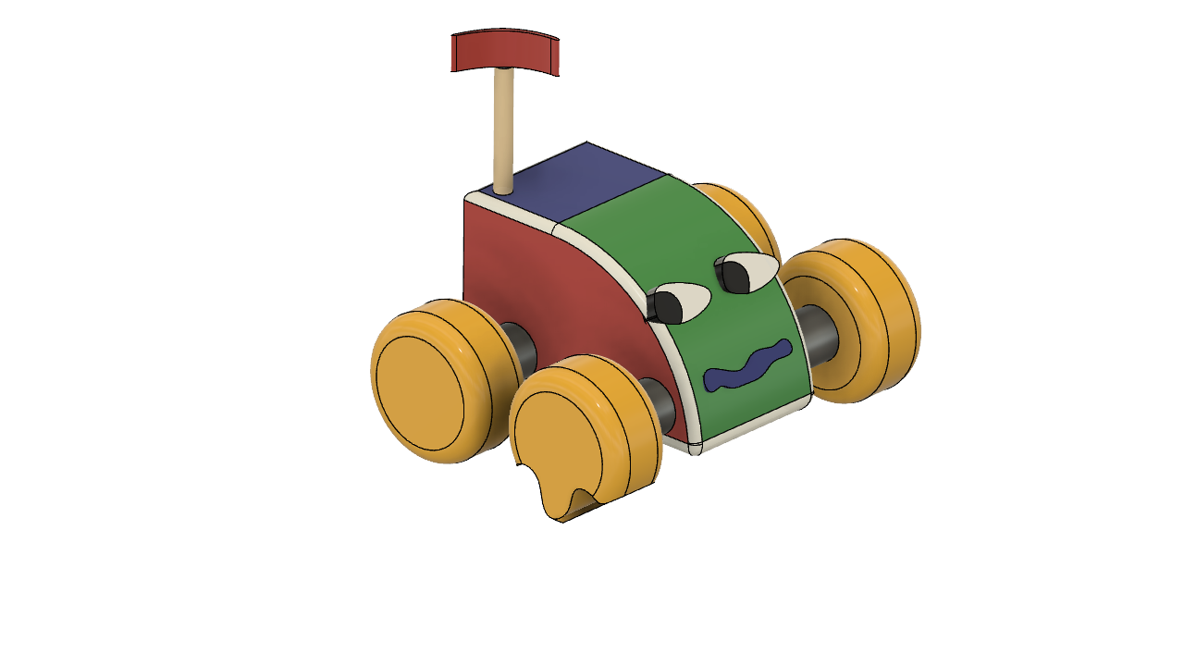
SERBROKER
“The change is coming, let us be the authors” We believe that we must be part of the changes for common good
OUTFITTING A MARS HABITAT:
A 3D PRINT CHALLENGE
TEAM
Shirley Lozada Thedy
Fernando A. Serra

Slide 2
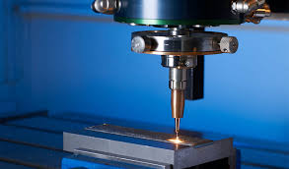
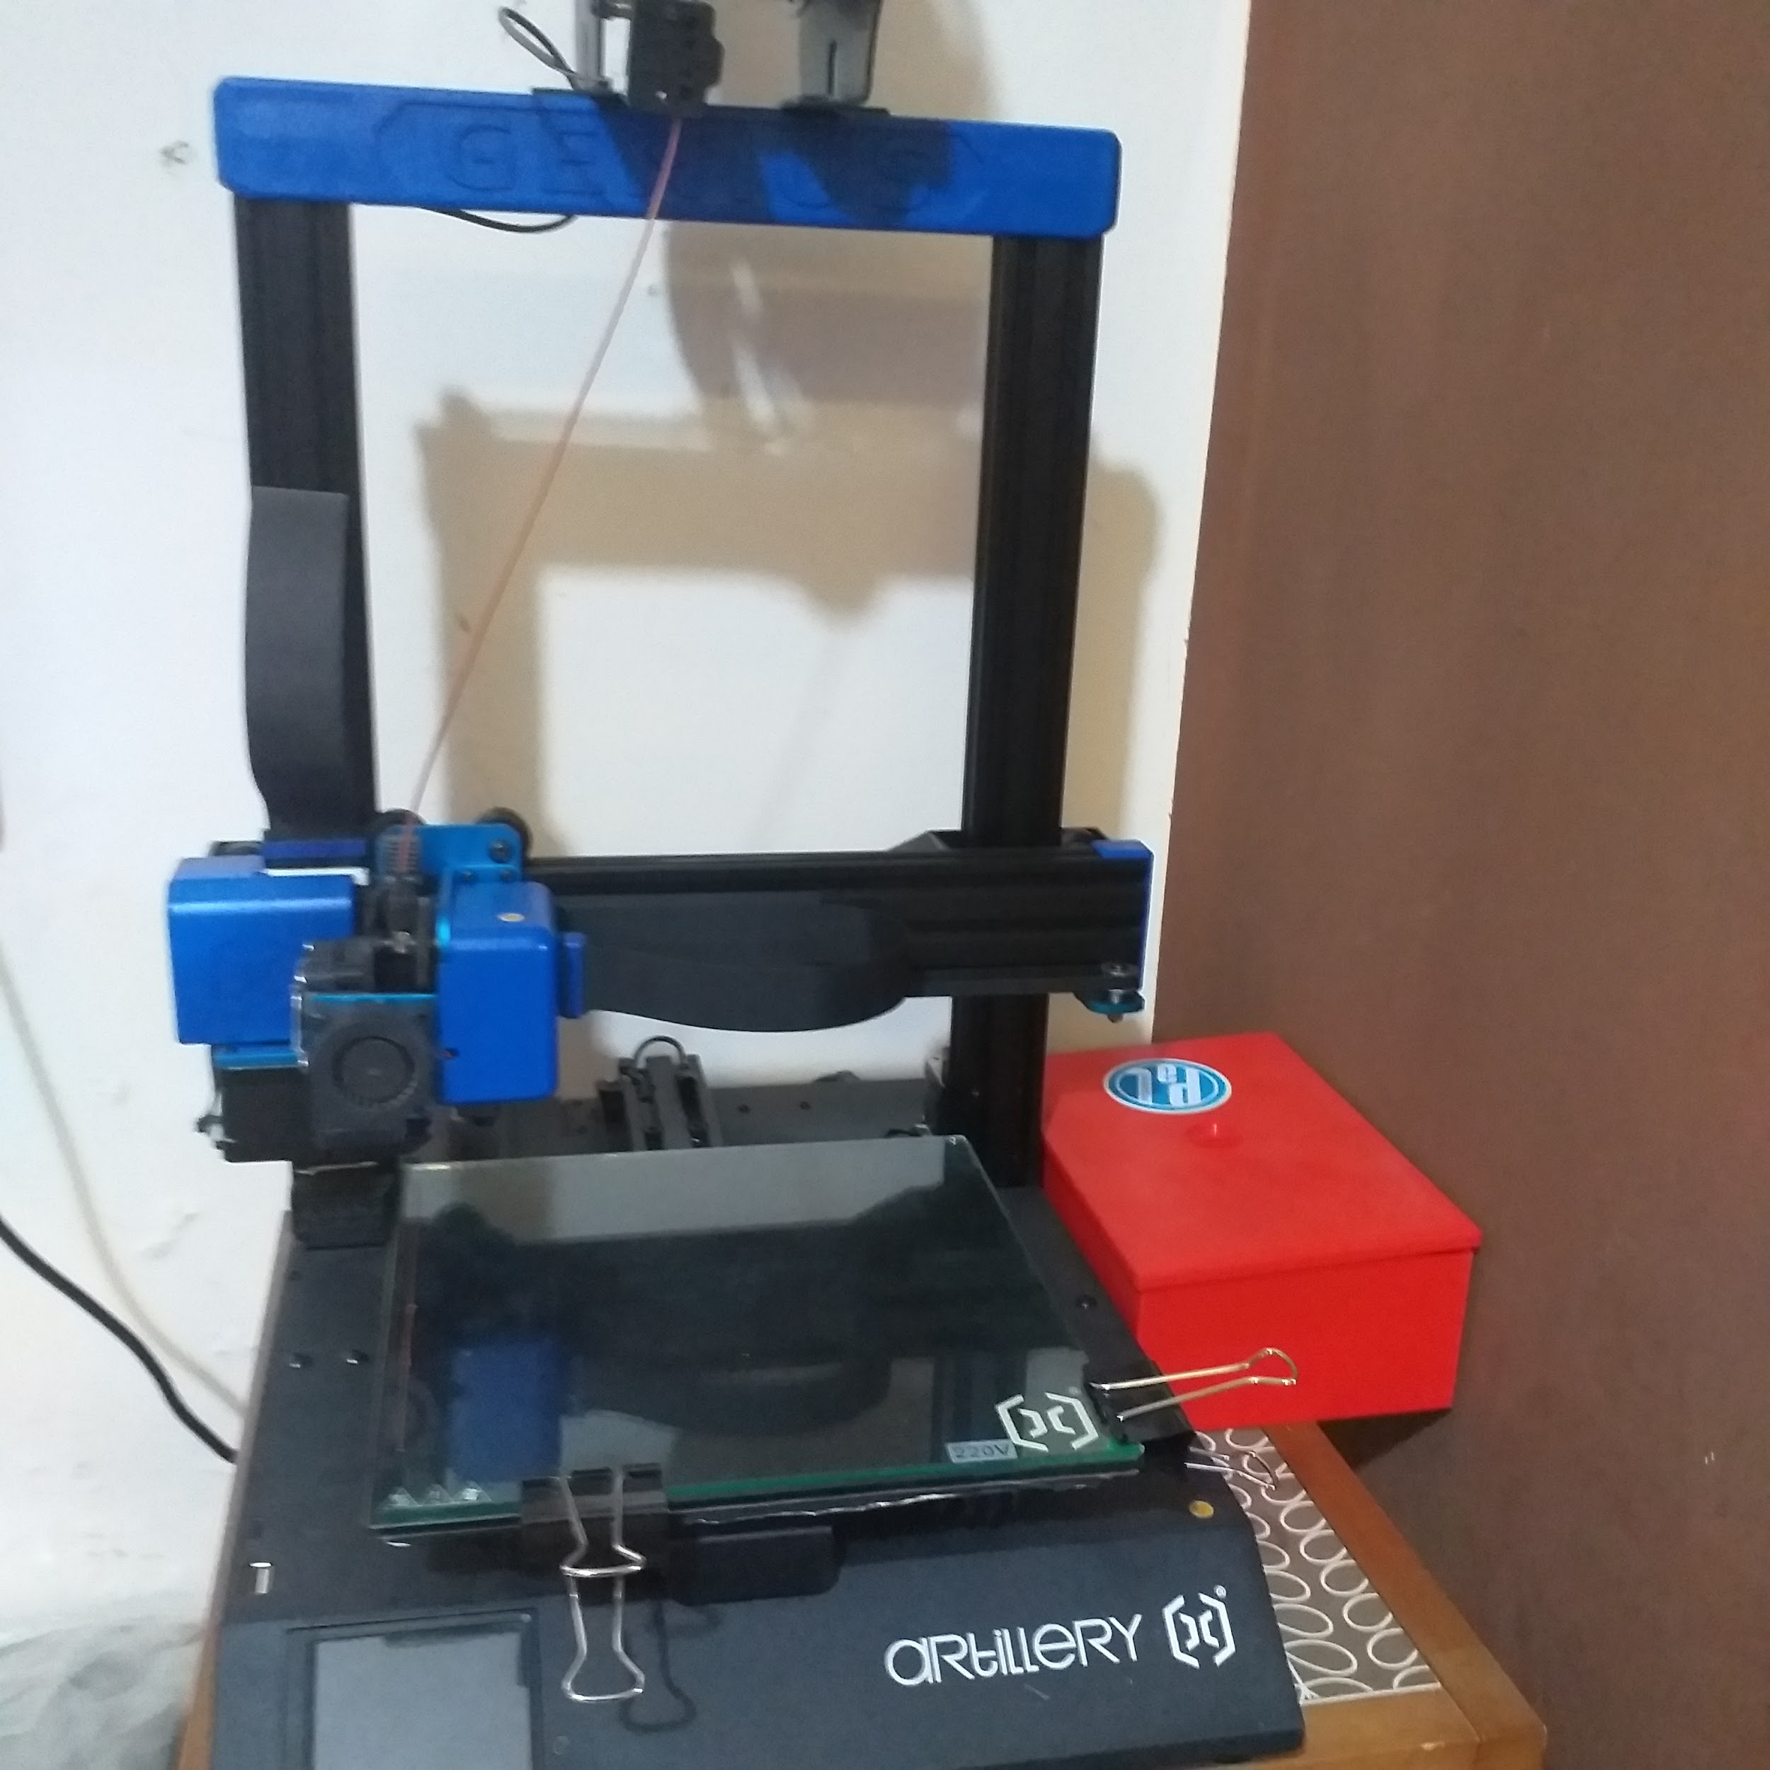
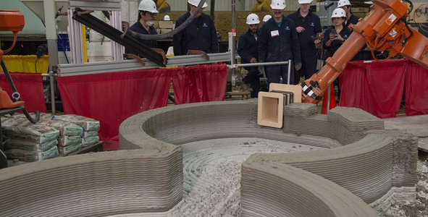
SERBROKER
Understanding the challenge
We got to mars, one year mission, water and food for now
a- A broken Rover wheel/tyre,
b- Tools were lost
c- There are not many real estate elements or work tables
Short-term challenge is to design the three main elements a-b-c
We have three printers with the following characteristics:
Steel
Plastic
Cement
-LOW SUPPLY
-SMALL PIECES
-Res: 0.1
-MORE MATERIAL
-LARGE PIECES
-RES 0.1
-LARGE OBJECTS
-OUTSIDE THE HABITAT
-RESOLUTION 25MM

Slide 3
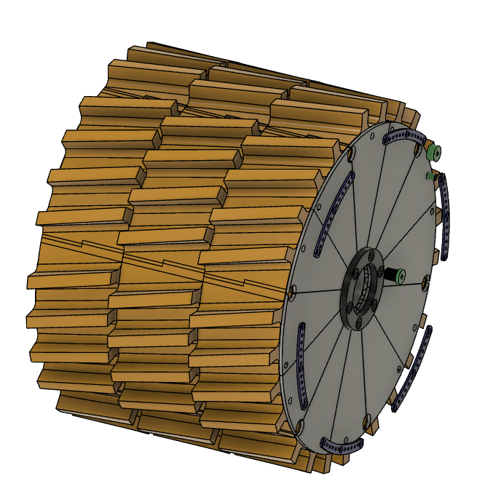
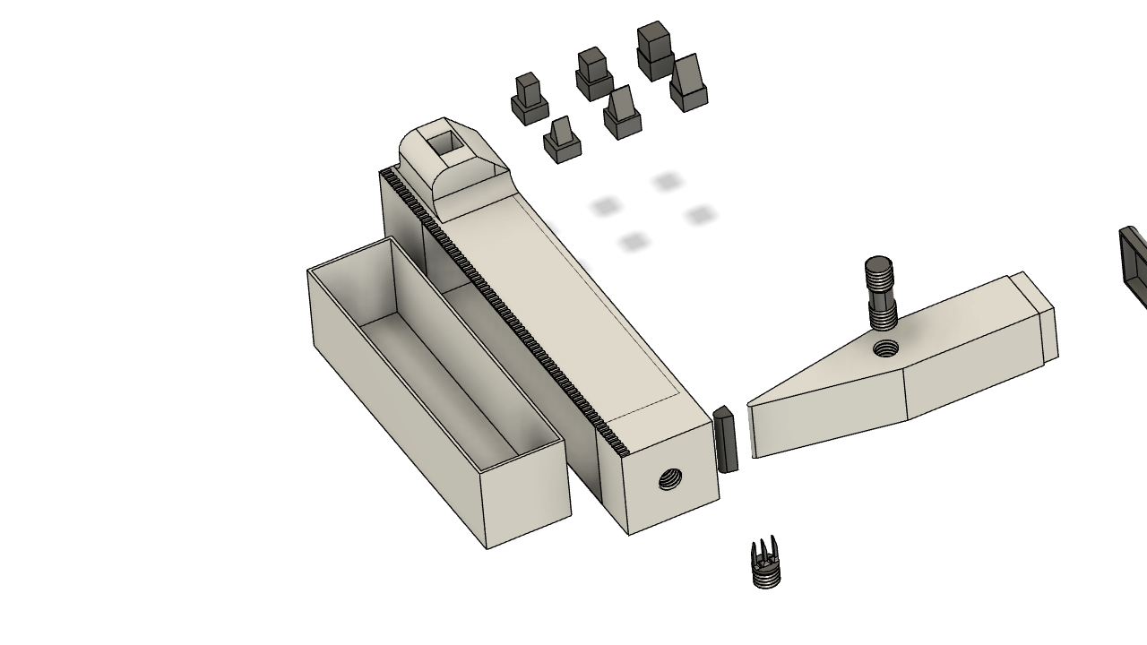
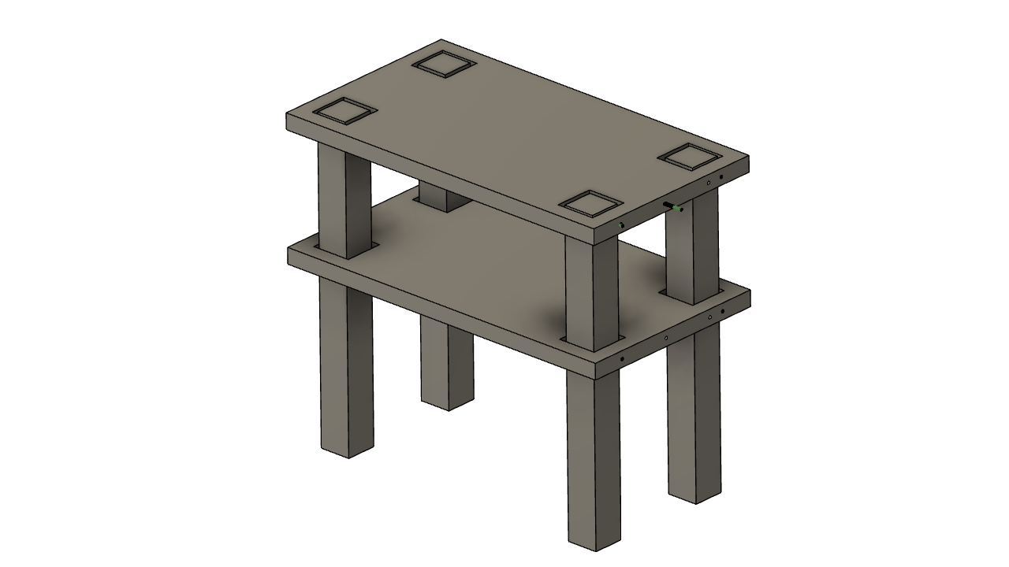
SERBROKER
Solutions
1-Rover Wheel
2-Cover - Tread - Steering
3- Lid
(METAL AND POLYMER)
1- Multifunctional Tool
(METAL AND POLYMER)
multitasking table
(CEMENT)

Slide 4
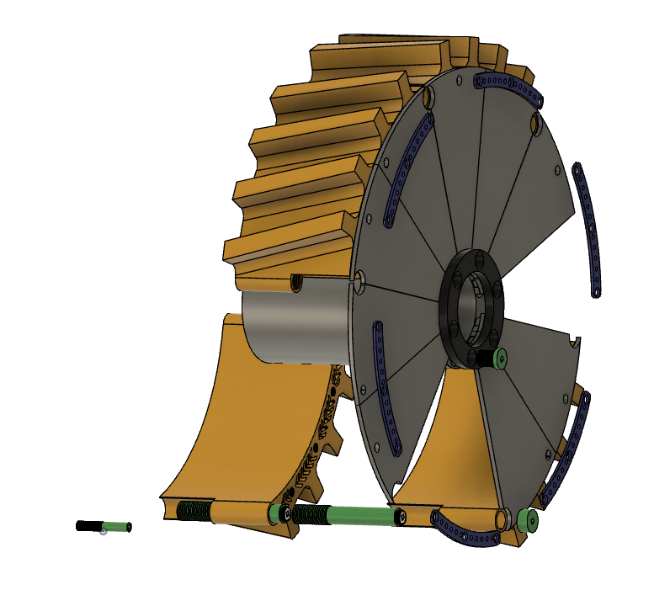
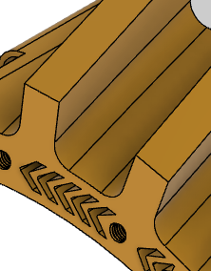
SERBROKER
Solutions wheel - tire - cap
Higher and more inclined tread.
Outer Lid
rubber coveramortiguada
Anillo. Parte superior. ext. Gomas
Lid support
Tornillos de sujeción
secondary screw
main screw

Slide 5
SERBROKER
Solutions Multifunction Tool
Screwdriver tools
tool handle
Strike tool
Threaded coupling
Internal box
Hammer
Ruler in mm
Fork

Slide 6
SERBROKER
Solution: multitasking table
Screw
Screw Fastener
One or several levels

Slide 7
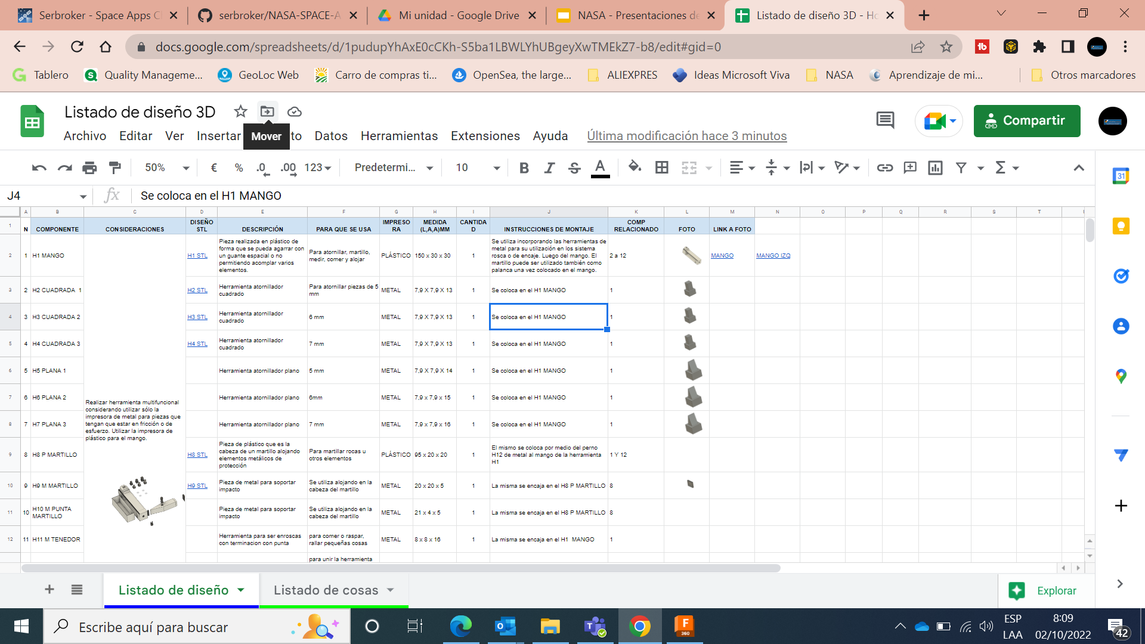
SERBROKER
Data sheet for 3D printing
30 STL DESIGN PIECES (See in the following Link)

Slide 8
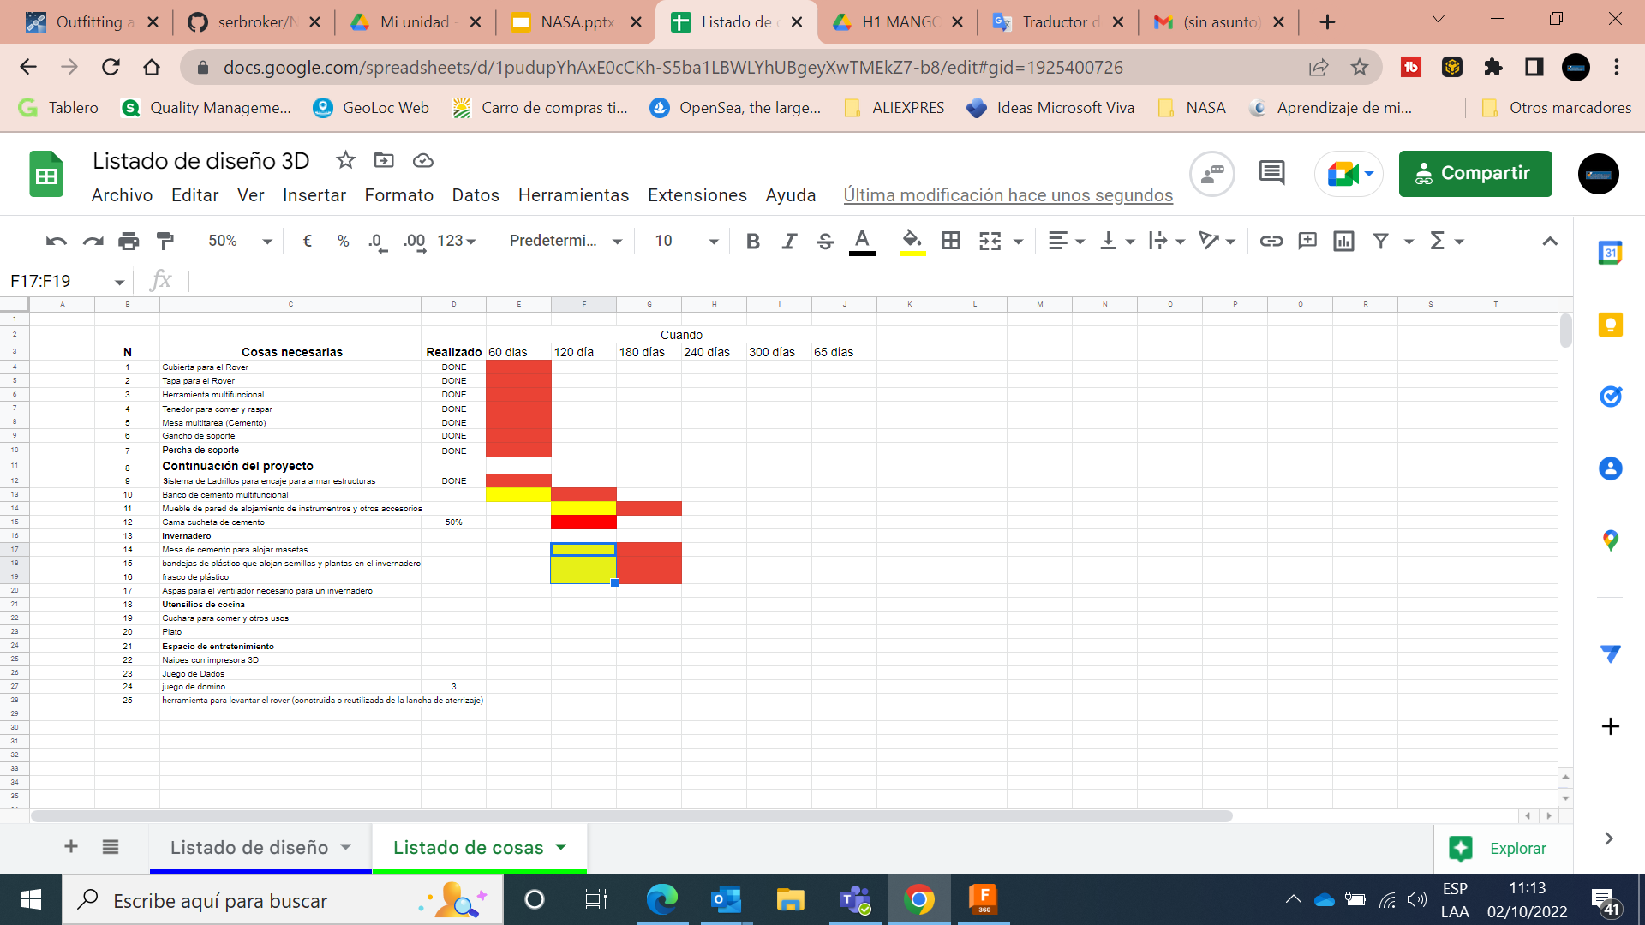
SERBROKER
Continuity of the proyect
THANK YOU !

